Slide 1

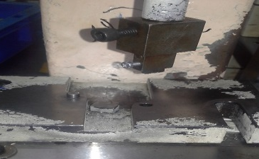
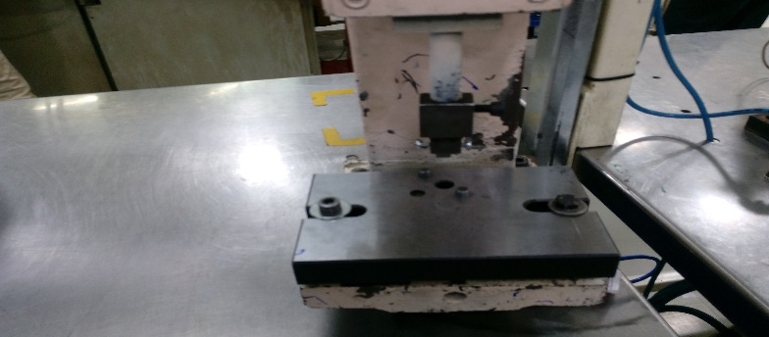
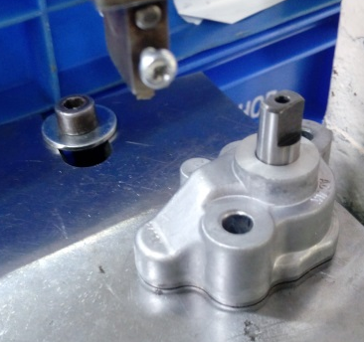

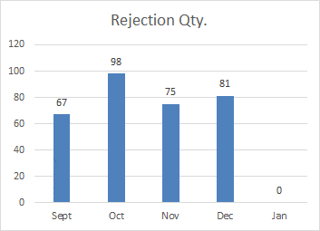
P15
TPM CIRCLE NO :- 01
ACTIVITY
KK
QM
PM
JH
SHE
OT
DM
E&T
KAIZEN IDEA SHEET
TPM CIRCLE NAME: Achiever
LOSS NO. / STEP
DEPT :- Assembly
RESULT AREA
P
Q
A
B
C
D
S
M
CELL : Oil Pump A285
CELL NAME: Oil Pump
MACHINE / STAGE
OPERATION
KAIZEN THEME : To reduce in house rejection of body damage at A285 at oil pump date punching operation
IDEA : To Provide new modify fixture for number punching
PROBLEM PRESENT STATUS: Body damage on A285 number punching
COUNTERMEASURE:- Fix Position for number punching fixture
BENCHMARK
TARGET
30/12/2016
KAIZEN START
03/12/2016
:
TDC
30/12/2016
KAIZEN FINISH
1/1/2017
TEAM MEMBERS: Kalubai Ovhal,
Mohan Kate
BENEFITS :-1) To reduce in house rejection
Before
After
KAIZEN SUSTENANCE
WHY - WHY ANALYSIS :-
Why1 : A285 body damage in Number punching operation
Why2: Number punching fixture position not fix
Why3: Give fix position for number punching
Why4: No. punching fixture not fixed
RESULT :-
1) Zero in-house rejection
WHAT TO DO:-Modify fixture
HOW TO DO: Give fix position
FREQUENCY :-
SCOPE & PLAN FOR HORIZONTAL DEPLOYMENT
Sr No | CELL | TDC | RESP. | STATUS
1
2
ROOT CAUSE : No. punching fixture not fixed
REGISTRATION NO. & DATE: 28/11/2016
REGISTERED BY: Kalubai Ovhal
MANAGER’S SIGN :- Janardhan Sathe

